Slide 1

Case Study on
Mining
BBA 2nd SEM (2022-23)
Submitted By-
Shankh Bansal
AU22C1013
Submitted To-
Dr. Manesh Patil

Slide 2
Contents
Introduction
Surface mining
Underground mining
Environmental impacts of mining
Acid mine drainage
Impacts on air quality
Heavy metal contamination
Erosion and sedimentation
Other effects
Social impacts of mining
Conclusion
Reference

Slide 3
Introduction
Mining is the extraction of valuable minerals or other geological materials from the earth from an ore body, lode, vein, seam, or reef, which forms the mineralized package of economic interest to the miner.
Minerals are the natural resources which play an important role in the economic development of the country. But the extraction and mining of these natural resources leads to some adverse effect on our environment as well.

Slide 4
Surface Mining
Surface mining, including strip mining, open-pit mining and mountain top removal mining, is a broad category of mining in which soil and rock overlying the mineral deposit are removed.
Strip mining (also known as open cast) involves scraping awayearth and rocks to get to minerals buried near the surface.
It can cause changes in the topography and drainage.
Open pit mining, where material is excavated from an open pit.
Open pit mining exposed rocks prone to weathering and polluting.
Mountaintop removal mining is a form of coal mining that uses explosives to blast overburden off the top of some mountains.
It effects the landscape, wildlife etc..

Slide 5
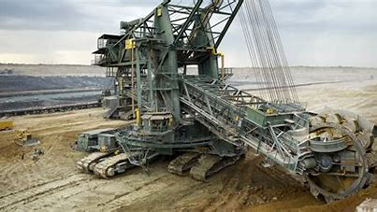
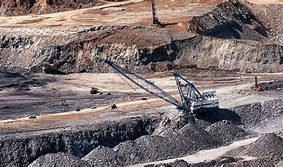
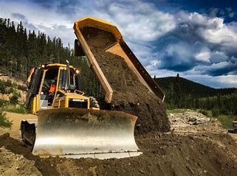

Slide 6
Underground Mining
Sub surface mining
Extracting minerals from under the Earth crust.
Tunnels closely follow the ore body.
It has a potential for land subsidence and tunnel collapse.
It can release toxic compounds to air and water.

Slide 7
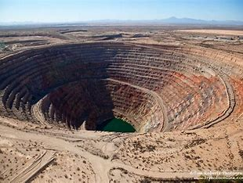
Environmental Impacts of Mining
Acid mine drainage
Impacts on air quality
Heavy metal contamination
Erosion and endangered species habitat

Slide 8
Acid Mine Drainage
Outflow of acidic water from metal mines or coal mines.
This toxic water leaks out of abandoned mines to contaminate groundwater, streams, soil, plants. animals and humans.
As a result an orange color can blanket the river. estuary or sea and kill aquatic life and making surface water unusable as drinking water.

Slide 9
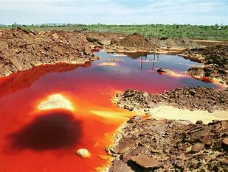
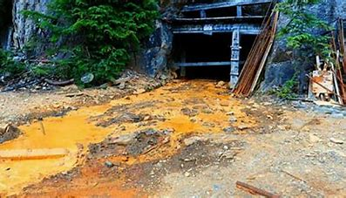

Slide 10
Impacts on air quality
Airborne emissions occur during each stage of the mine cycle, but especially during exploration, development, construction, and operational activities.
Coal mine methane, less prevalent in the atmosphere than CO2, but 20 times as powerful as a greenhouse gas, and is released during the coal mining process. Most coal mine methane come from underground mines.
Carbon-monoxide (CO), carbon-dioxide (CO2). methane (CH4), sulphur dioxide (SO2), nitrous oxides (NOx) and other greenhouse or toxic gases - as well as fly ash from vents and fissures.

Slide 11
Heavy Metal Contamination
Release of harmful trace element e.g.. Cu, Pb, Cd etc. leads to the contamination of surface water.
Underground water is also contaminated due toseepage and infiltration of leached drainage.
Elevated levels of cyanide and nitrogen compounds(ammonia, nitrate, nitrite) can also be found in waters at mine sites, from heap leaching and blasting.

Slide 12
Erosion and sedimentation
Mineral development disturbs soil and rock in the course of constructing and maintaining roads, open pits, and waste impoundments.
Loss of landscape and beauty of surrounding.
Excessive sediment can clog riverbeds and smother watershed vegetation, wildlife habitat and aquatic organisms.

Slide 13
Other effects
Deforestation
Wastage of land as it neither remain suitable for industrial use nor for agriculturalpurposes.
Loss of flora and fauna.
Degradation of soil quality and fertility.
Land subsidence and slope failure.

Slide 14
Social impacts of mining
Human displacement and resettlement.
Impacts on migration.
Impacts on livelihoods.
Lost access to clean water.
Impacts on public health.

Slide 15
Conclusion
Unregulated mining has the potential to release harmful substances into the soil, air, and water.
Protecting the environment and human health is the prevention method.
Water management and treatment.
Reduction of acid rock drainage.
If no action is taken to remediate the many environmental problems inherent to modern mining, the end cost for governments and communities would be devastating.

Slide 16
Reference
Principles of Environmental chemistry- James E Girard.
Environmental chemistry-Asim K Das.
https://en.wikipedia.org/wiki/Acid_mine_drainage
https://www.vectorsolutions.com/resources/blogs/what-is-surface-mining

